Slide 1
Using Flutter for Cross Platform Application Development
Darius-Daniel Calugar
May 2021

Slide 2
What is Flutter?

Slide 3
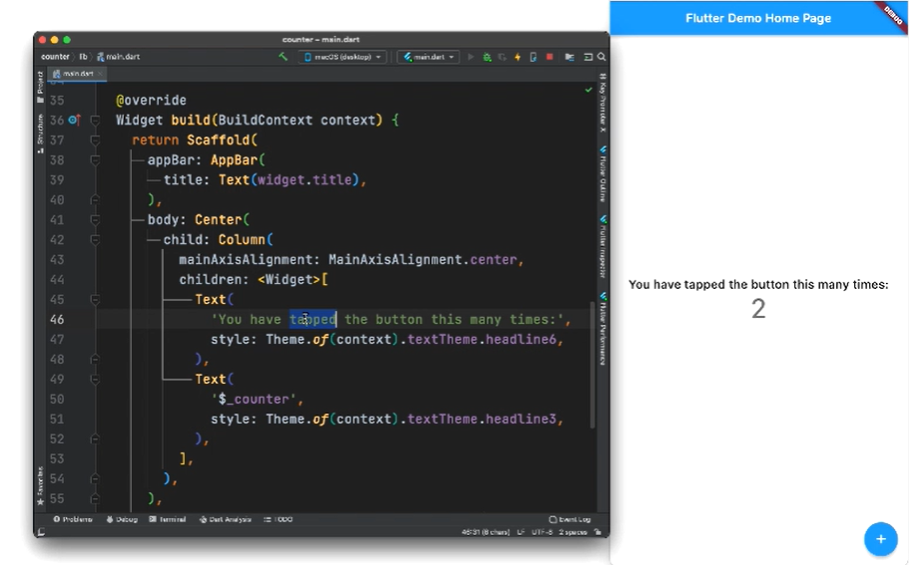
Flutter is an open source UI software development kit created by Google
It allows developers to create cross platform applications for Android, iOS, Windows, Mac, Linux and web with a single codebase.
Flutter applications are written in Google’s Dart programming language.
Fig. 1 - Flutter Demo Application Code (https://flutter.dev)
Notes:
Flutter is Google’s UI software development kit that allows developers to create cross platform applications for Android, iOS, Windows, Mac, Linux and web with a single codebase, which means that both the application functionalities and UI are written in the same language.
That language is Google’s Dart.

Slide 4
Dart programming language

Slide 5
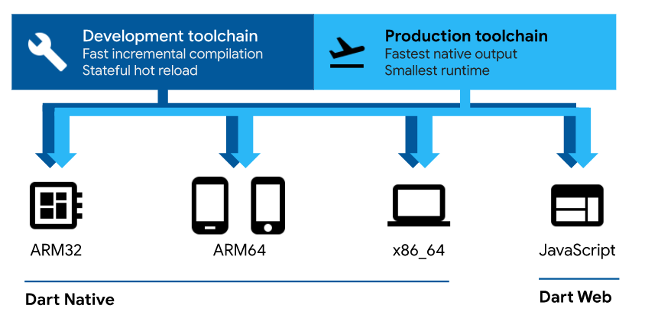
Dart programming language
Dart is a programming language primarily used for client-side development that offers increased productivity for multi-platform development.
Applications that target desktop or mobile devices use either just-in-time compilation with the standalone Dart VM or ahead-of-time compilation directly to machine code.
Dart provides a source-to-source compiler to JavaScript (dart2js) that allows it to run on mainstream web browsers.
Fig. 2 - Dart cross-platform overview
Notes:
Dart is a programming language primarily used for client-side programming that offers increased productivity for multi-platform development.
Native applications that target desktop / mobile devices user either JIT compilation with the standalone Dart VM or AOT compilation directly to machine code.
So desktop applications use the Dart VM and mobile applications use AOT compilation.
Dart also provides a source-to-source compiler to JavaScript that allows it to run on web browsers.
So, as you can see, dart offers a lot of platform flexibility.

Slide 6
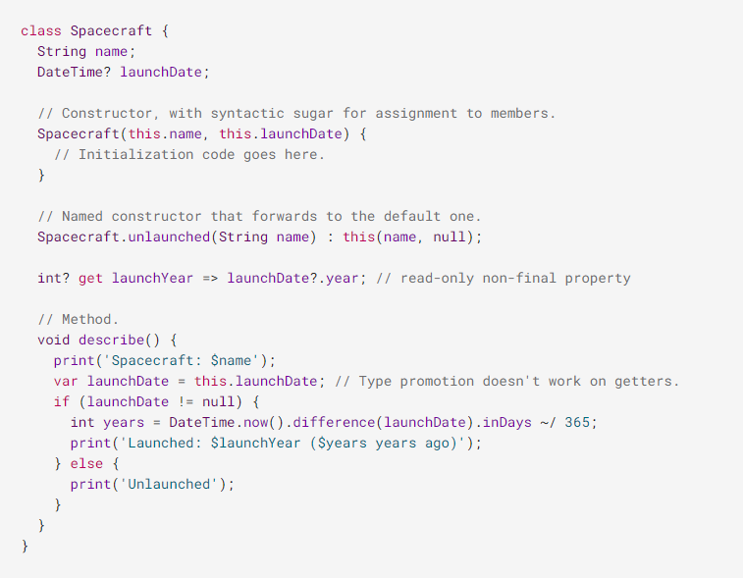
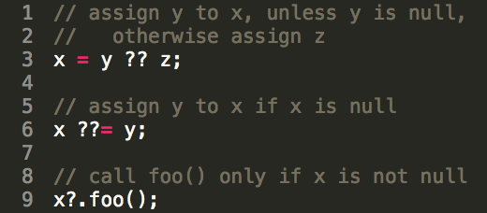
Dart programming language
Dart syntax is similar to that of type-safe languages (Java, C#), but it also introduces the type flexibility of scripting languages through the ‘dynamic’ keyword
Dart also provides sound null-safety, which means that variables can be null only if specified (Object? obj).
Fig. 3 - Dart null-aware operators
Fig. 4 - Dart syntax example
Notes:
Dart’s syntax is similar to that of type-safe languages like Java, but it also introduces the type flexibility of scripting languages such as JavaScript or Python.
And it does so through the ‘dynamic’ keyword.
Dart also provides sound null-safety, which means that variables may be null only if specified by the developer.

Slide 7
Flutter framework

Slide 8
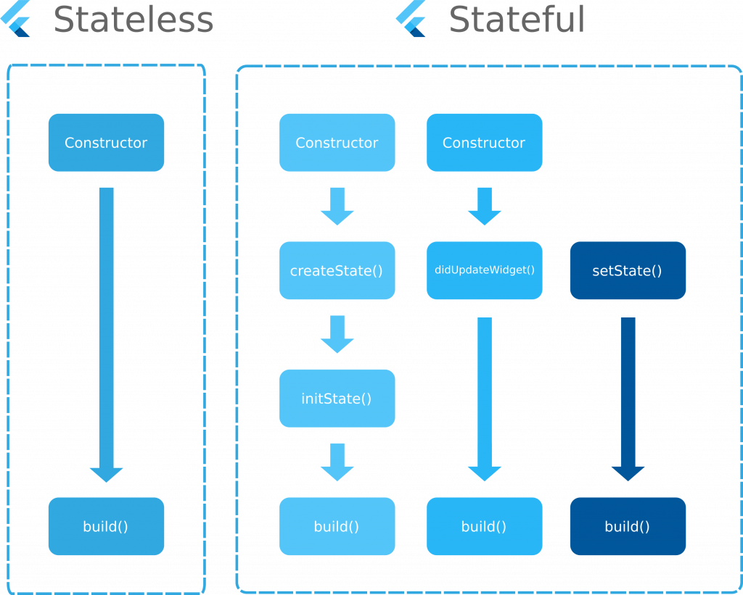
Flutter framework
Flutter is a reactive and pseudo-declarative framework. Meaning the developer only provides a mapping between the application state and the interface state.
A flutter widget declares it’s UI by implementing the build() method that converts widget state to UI.
Widgets can be one of 2 types: Stateless widgets that build once, and Stateful widgets rebuild each time the state changes.
Fig. 6 - Flutter stateless & stateful widget build behavior

Slide 9
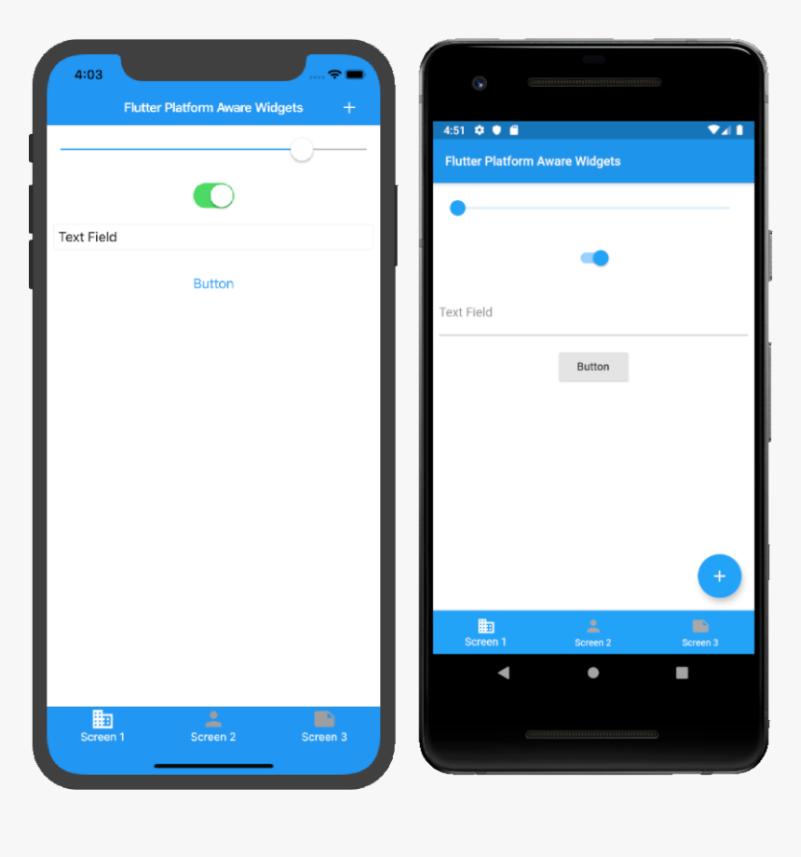
Flutter framework
Flutter provides two sets of design-specific widgets:
Material widgets (Android & Windows)
Cupertino widgets (iOS & Mac).
Each widget type conforms to its respective design language specifications.
Fig. 7 - Flutter Cupertino & Material UI comparison

Slide 10
Bibliography
Dart
https://dart.dev/overview
https://dart.dev/codelabs/async-await
https://medium.com/@thinkdigitalsoftware/null-aware-operators-in-dart-53ffb8ae80bb
https://medium.com/dartlang/dart-2-stable-and-the-dart-web-platform-3775d5f8eac7
https://en.wikipedia.org/wiki/Dart_(programming_language)
Flutter
https://flutter.dev/docs
https://flutter.dev/docs/resources/architectural-overview
https://www.flutterclutter.dev/flutter/basics/statelesswidget-vs-statefulwidget/2020/1195/
https://medium.com/flutter/do-flutter-apps-dream-of-platform-aware-widgets-7d7ed7b4624d
https://www.smashingmagazine.com/2018/06/google-flutter-mobile-development/
https://en.wikipedia.org/wiki/Flutter_(software)

